Slide 1
Python Fundamentals II & Problem Framing

Slide 2
Learning Objectives
1
Master Python Data Structures
Work confidently with Python's core data structures and understand how structure affects performance, clarity, and correctness
2
Make Smart Data Structure Decisions
Recognize when data should be ordered, immutable, unique, or mapped by keys—decisions that matter in real systems
3
Apply Systems Thinking
Frame problems using systems thinking, identifying stakeholders, incentives, and constraints before introducing AI as a solution
4
Create Stakeholder Maps
Produce a basic stakeholder map that reflects real-world complexity rather than simplified assumptions

Slide 3
Data Structures
Data structures are specialized formats for organizing data efficiently. They impact performance, maintainability, and scalability.
Time Complexity Comparison
List Search
O(n)
Dict Lookup
O(1)
Set Member Test
O(1)

Slide 4
WHY DATA STRUCTURES MATTER
KEY BENEFITS:
Efficiency: Proper structures dramatically reduce execution time. Dictionary lookups run in O(1) time versus O(n) for list searches.
Organization: Logical grouping improves code maintainability and reduces complexity for team collaboration.
Readability: Well-chosen structures make code self-documenting and reduce need for extensive comments.
Scalability: Right choices enable systems to grow from thousands to millions of records seamlessly.

Slide 5
OVERVIEW OF DATA STRUCTURES
Lists: Sequential memory blocks enable O(1) indexed access.
Dictionaries: Hash tables provide O(1) average-case lookups through key hashing.
Tuples: Similar to lists but immutable and slightly faster.
Sets: Hash-based like dicts, optimized for O(1) membership testing.
MEMORY STORAGE PATTERNS
Complexity Reference
Contiguous (Lists)
Structure
Access
Search
Insert
0
1
2
3
4
List
O(1)
O(n)
O(n)
Hash Table (Dictionaries)
Tuple
O(1)
O(n)
N/A
k0
k1
k2
Dict
O(1)
O(1)
O(1)
Set
N/A
O(1)
O(1)

Slide 6
INTRODUCTION TO LISTS
A list is a Python data structure used to hold multiple related items together, similar to how we write items in a shopping list or names in a class register.
It allows us to store and work with multiple related items in Python at the same time, instead of creating many separate variables for each item.

Slide 7
Characteristics of list
Key characteristics: • Stores items in a specific order • Can be modified after creation • Can hold multiple data types
Each item has a position that Python can reference

Slide 8
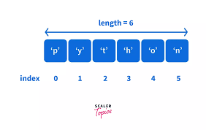
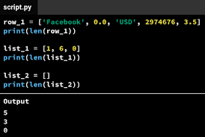
INDEXING IN LISTS
Positive Indexing Access elements from the **start** of the list (index 0, 1, 2...) ```python colors = ['red', 'green', 'blue'] print(colors[0]) # 'red' print(colors[1]) # 'green' print(colors[2]) # 'blue' ``` Negative Indexing Access elements from the **end** of the list (index -1, -2, -3...) ```python print(colors[-1]) # 'blue' (last) print(colors[-2]) # 'green' print(colors[-3]) # 'red' (first)

Slide 9
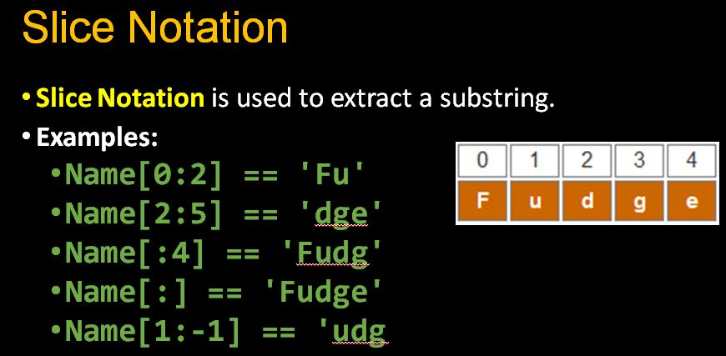
LIST SLICING - EXTRACTING SUBLISTS
Slicing allows us to work with subsets of a list.
With slicing, we can: • Extract a range of elements • Skip elements using steps • Reverse the order of a list

Slide 10
COMMON LIST METHODS
Operations Visual
append(4)
[1, 2, 3]
[1, 2, 3, 4]
insert(1, 5)
[1, 2, 3]
[1, 5, 2, 3]
remove(2)
[1, 2, 3]
[1, 3]
pop()
[1, 2, 3]
[1, 2]

Slide 11
WHEN TO USE LISTS
Decision Flow
Does order matter?
↓ YES
Will data change?
↓ YES
Duplicates allowed?
↓ YES
✓ USE LIST

Slide 12
TUPLES
A tuple is similar to a list, but with one key difference.
Characteristics: • Ordered collection of items • Immutable after creation • Slightly more memory-efficient than lists
Tuples are useful for representing fixed records.

Slide 13
WHY TUPLES EXIST
Tuples help enforce data integrity.
They are useful when: • Values should not be modified • Data represents a constant record • You want to avoid accidental changes
This makes programs safer and more predictable.

Slide 14
LIST VS TUPLE
Lists [ ]
Tuples ( )
✓ Mutable
✓ Immutable
✓ Can change values
✓ Cannot change
VS
✓ Flexible operations
✓ Data protection
✓ More memory overhead
✓ Memory efficient

Slide 15
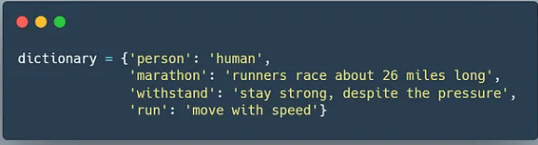
DICTIONARIES
A dictionary stores data as key-value pairs.
Core features: • Each key uniquely identifies a value • Data is accessed by meaning, not position • Highly efficient for lookups
Dictionaries closely resemble real-world data structures.

Slide 16
Dictionary Operations Visual
student = {'name': 'Alice', 'age': 25, 'grade': 'A'}
'name'
'Alice'
'age'
25
'grade'
'A'
KEY (identifier)
VALUE (data)

Slide 17
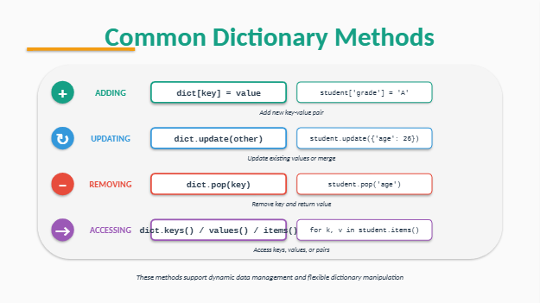
COMMON DICTIONARY METHODS

Slide 18
ACCESSING DICTIONARY VALUES
Dictionary values are accessed using keys.
This allows: • Fast retrieval of information • Clear and descriptive data access • Reduced dependency on index positions
This is essential in large systems.

Slide 19
WHEN TO USE DICTIONARIES
Use dictionaries when:
• Data elements have labels or identifiers • Fast access to values is required • Relationships between data points matter more than order

Slide 20
SETS
1
Uniqueness
Set Operations
Removes duplicates automatically
2
Unordered
No indexing or position-based access
A
{1,2,3}
B
{3,4,5}
3
Mutable
Add/remove elements (elements must be hashable)
4
Fast O(1)
a | b
Union
→
{1, 2, 3, 4, 5}
Constant-time membership testing
a & b
Intersection
→
{3}
my_set = {1, 2, 3}
from_list = set([1, 2, 2, 3]) # removes duplicates
a - b
Difference
→
{1, 2}

Slide 21
WHY SETS ARE USEFUL
Sets are commonly used to:
• Remove duplicate entries • Test whether an item exists in a collection • Compare groups of data • Perform logical comparisons
They simplify many common data-cleaning tasks.

Slide 22
SET OPERATIONS
∪
Union
a | b
Combining unique values from both sets
{1, 2, 3} ∪ {3, 4, 5} = {1, 2, 3, 4, 5}
∩
Intersection
a & b
Finding common values in both sets
{1, 2, 3} ∩ {3, 4, 5} = {3}
−
Difference
a - b
Identifying unique elements in first set
{1, 2, 3} − {3, 4, 5} = {1, 2}
Useful in data analysis, validation, deduplication, and comparison tasks

Slide 23
WHEN TO USE SETS
Sets are best used when:
• Uniqueness is required • Order is irrelevant • Comparison between groups is needed

Slide 24
CHOOSING THE RIGHT DATA STRUCTURE
Before choosing a data structure, ask:
• Does the order of elements matter • Will the data change over time • Are duplicate values allowed • Is fast lookup required

Slide 25
LIVE CODING SESSION
During this session, we will:
• Create and manipulate each data structure • Observe differences in behavior • Apply operations in simple scenarios
Focus is on understanding concepts, not speed.

Slide 26
PRACTICE EXERCISE
Participants will:
• Analyze a short real-world problem • Select an appropriate data structure • Justify their choice • Implement a simple solution
This reinforces conceptual understanding.

Slide 27
SYSTEMS THINKING & PROBLEM FRAMING

Slide 28
Introduction to Systems Thinking
CORE PRINCIPLES
Systems thinking examines interconnections, feedback loops, and emergent behaviors rather than isolated components.
Interconnectedness: Everything affects everything else. Changes ripple throughout the system.
Feedback Loops: Reinforcing loops amplify changes. Balancing loops resist changes.
Emergence: System behavior emerges from interactions, not individual parts.
Inputs
SYSTEM
Outputs
Feedback

Slide 29
Systems Thinking Framework
Interconnections
Long-term
Consequences
SYSTEMS
THINKING
Feedback
Loops
Emergent
Behavior

Slide 30
PROBLEM DEFINITION VS SOLUTION
A common mistake is starting with a solution.
Effective approach: • Clearly define the problem • Understand constraints • Identify objectives
A well-defined problem simplifies the solution.

Slide 31
PROBLEM SCOPING FRAMEWORK
5W + 1H Framework
WHAT?
A strong problem definition answers:
• What exactly is the problem • Who is affected by it • Why it matters now • How success will be measured
The problem
WHO?
Affected parties
WHY?
Why it matters
WHERE?
Boundaries
WHEN?
Timing patterns
HOW?
Success metrics

Slide 32
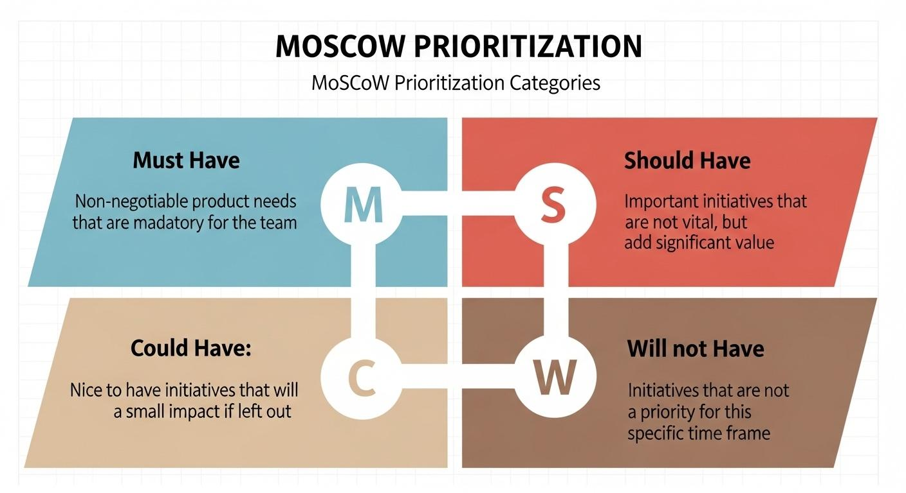
Moscow Prioritization

Slide 33
WHEN AI IS NOT THE ANSWER
AI may not be appropriate when:
• The problem is vague • There is insufficient data • Simple logic can solve it • Human judgment is critical
Not every problem requires AI.
AI Suitability Check
Clear problem?
↓ NO
Sufficient data?
↓ NO
Cost justified?
↓ NO
Interpretable OK?
⚠ DON'T USE AI

Slide 34
DEFINING SUCCESS METRICS
Good success metrics are:
• Clearly measurable • Aligned with stakeholder goals • Interpretable by non-technical users • Linked to real-world impact
Accuracy alone is rarely sufficient.

Slide 35
STAKEHOLDER MAPPING
WHAT IS A STAKEHOLDER
A stakeholder is any individual or group that:
• Is affected by the problem • Has influence over the system • Gains or loses from outcomes
Ignoring stakeholders leads to failure.

Slide 36
TYPES OF STAKEHOLDERS
Stakeholders may include:
End users • Decision makers • Implementers • Regulators • Indirectly affected groups
Each has different priorities.
High
Keep Satisfied
Manage Closely
Senior Mgmt
Regulators
Executives
Key Users
POWER
Monitor
Keep Informed
General Public
Tangential Teams
Front-line Staff
Advocates
Low
Low
INTEREST
High

Slide 37
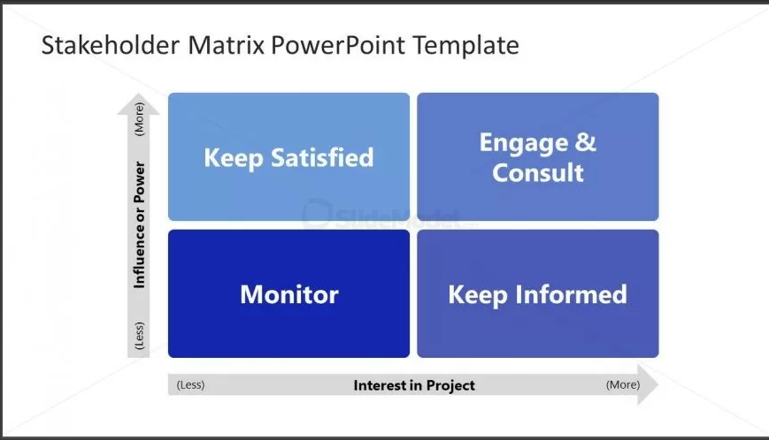
WHAT IS A STAKEHOLDER MAP
A stakeholder map is a visual representation of:
• Key stakeholders • Their influence and interest • Relationships and dependencies
It provides clarity and alignment.

Slide 38
WHY STAKEHOLDER MAPS MATTER
Stakeholder maps help to:
• Identify hidden risks • Align technical solutions with reality • Improve communication and trust

Slide 39
BUILDING A STAKEHOLDER MAP
Basic steps include:
• Identifying all relevant stakeholders • Grouping them logically • Assessing influence and interest • Mapping interactions

Slide 40
WORKSHOP INSTRUCTIONS
Participants will:
• Select a real-world problem • Identify key stakeholders • Create a simple stakeholder map • Prepare a brief explanation

Slide 41
CASE STUDY OVERVIEW
Case Study: Currency Converter for Nigerian Naira
Focus areas: • Problem framing • Stakeholder identification • Python functions and logic

